Slide 1
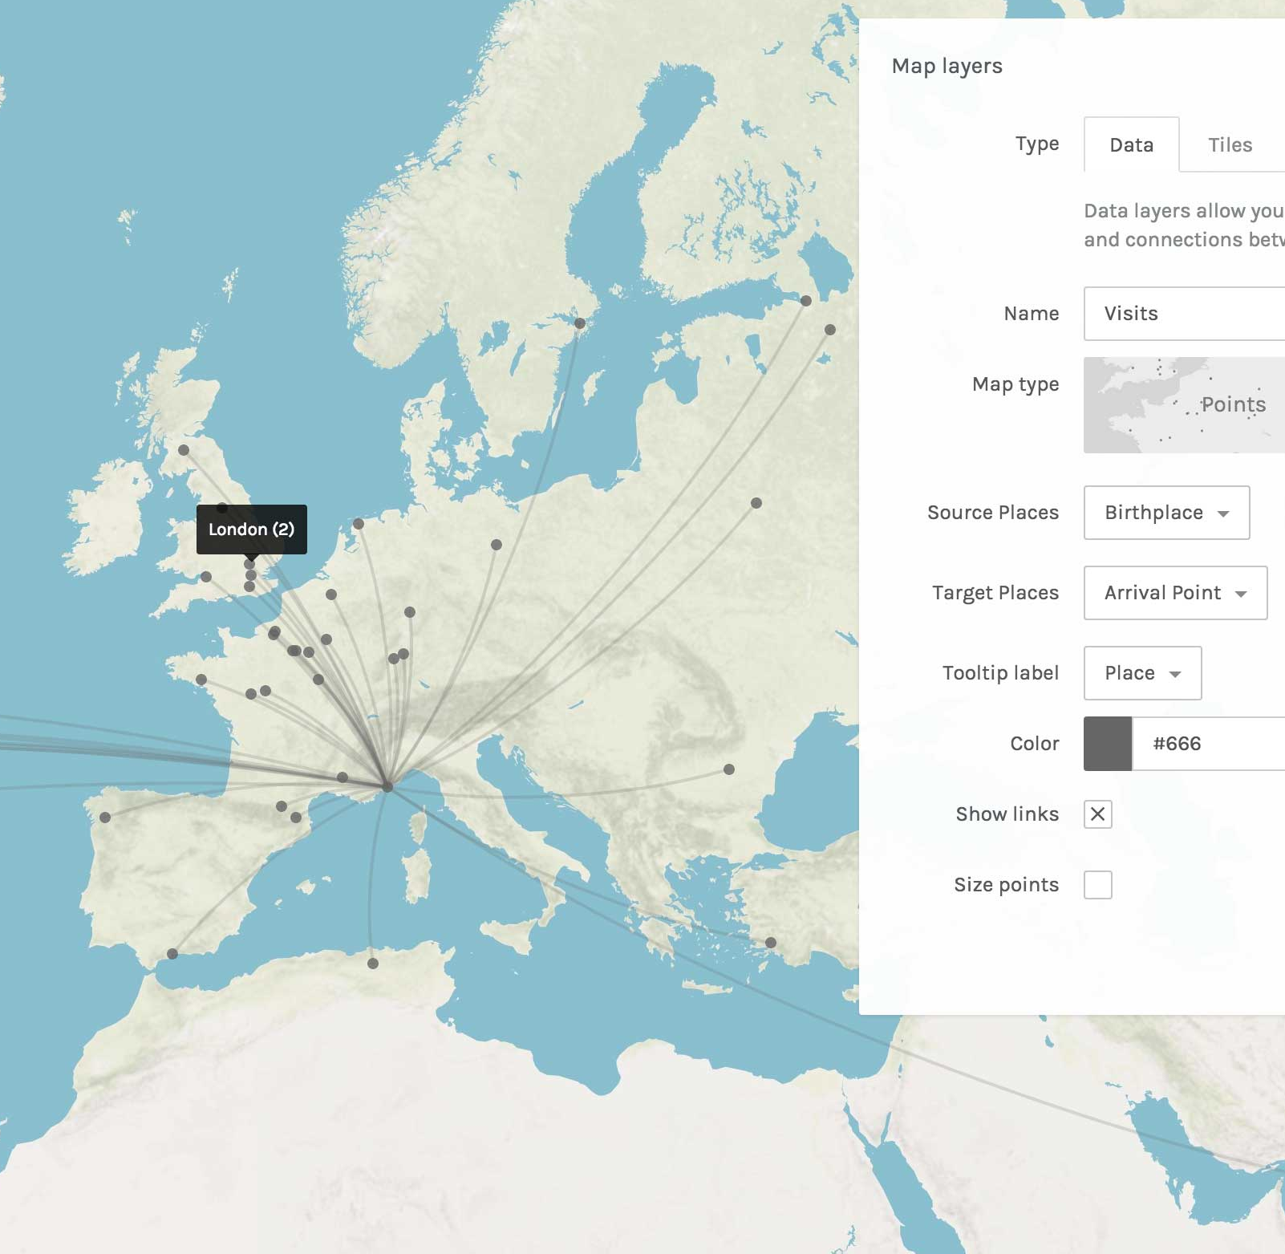
CREATING DIGITAL MAPS WITH Dariah Geobrowser & Palladio
DARIAH-DE WORKSHOP September 2019 Anna Aschauer & Monika Barget

Slide 2

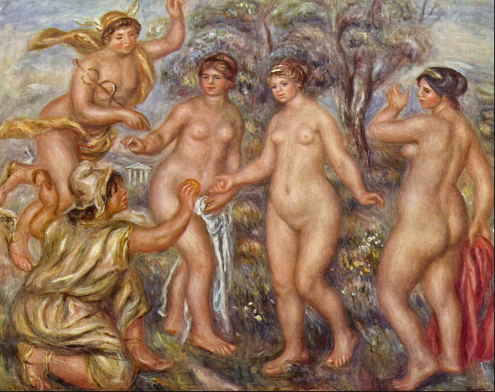
WER oder WAS IST PARIS?
What or who is PARIS? – Keep in mind that computers can only „read“ structured information!

Slide 3
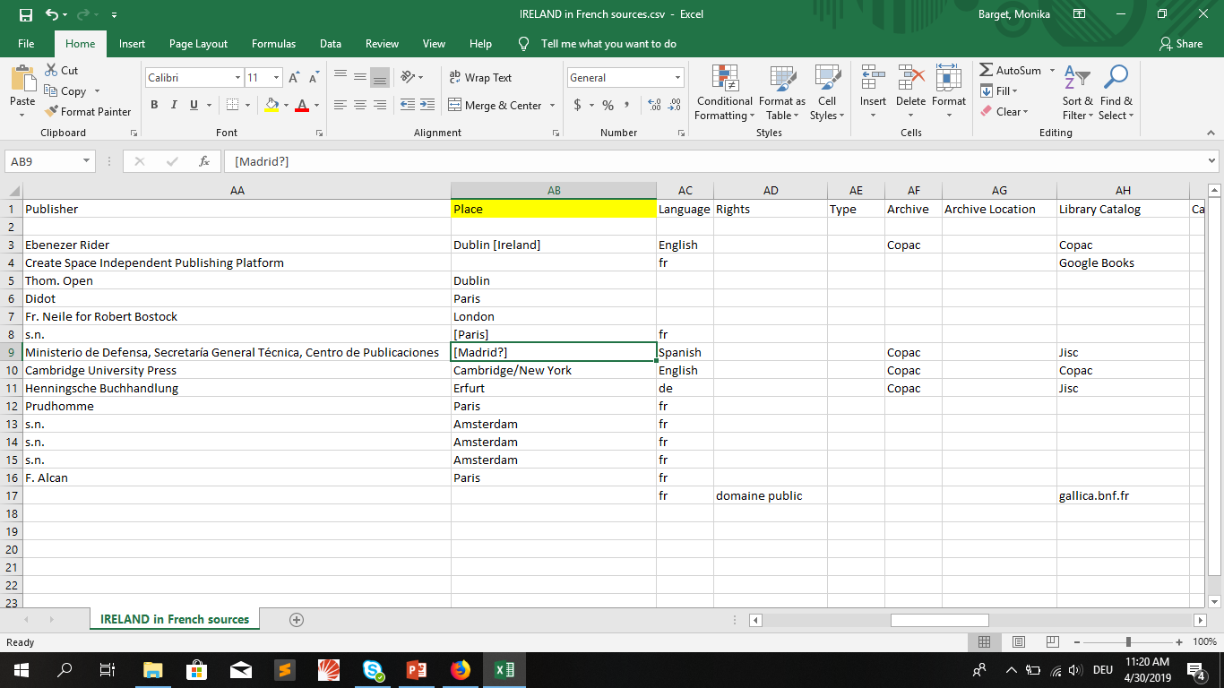
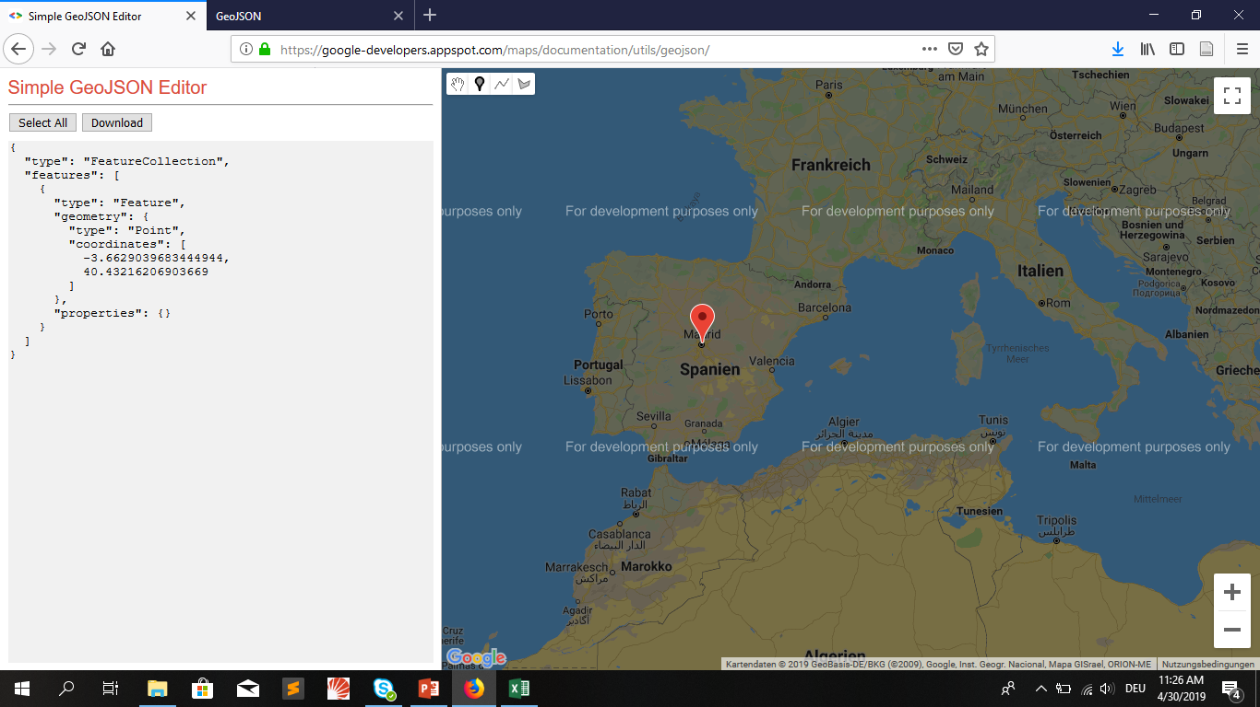
Technical Challenges of creating digital Maps
GEOCODING
Machine-readable geo-information
In order to display geo-information on maps, we at least need the latitude and longitude of places (lat-long!)
Indirect geo-information from textual sources

Slide 4
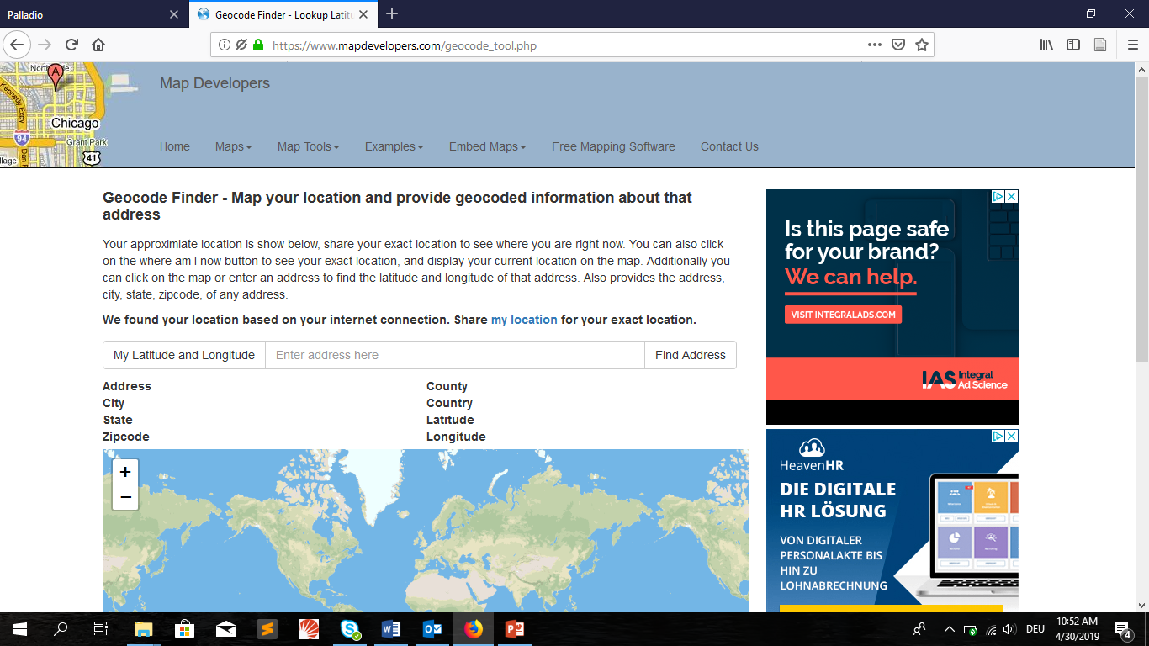
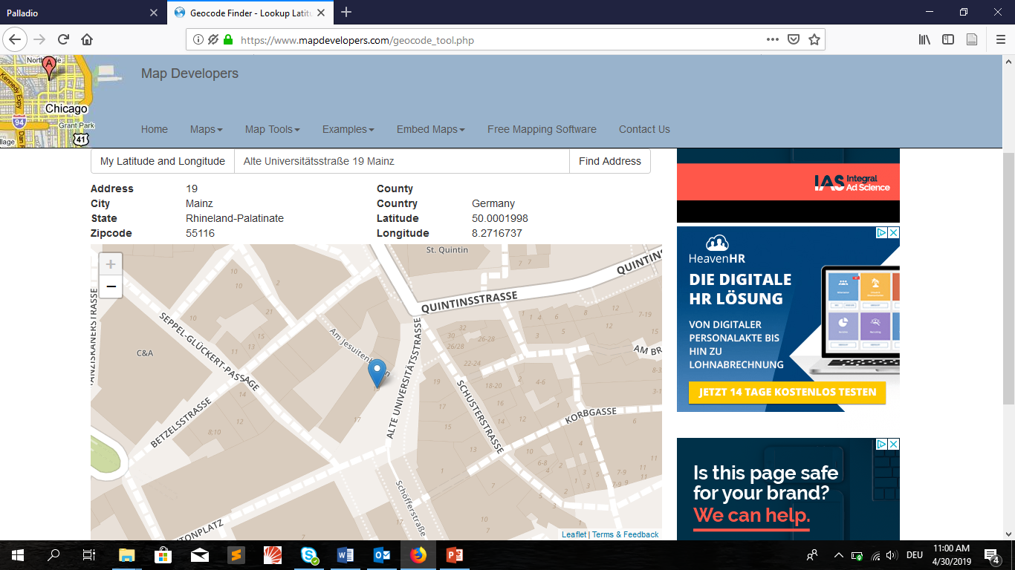
Geocoding Place names: manUALLY
e.g. with „Geocode Finder“ on www.mapdevelopers.com

Slide 5
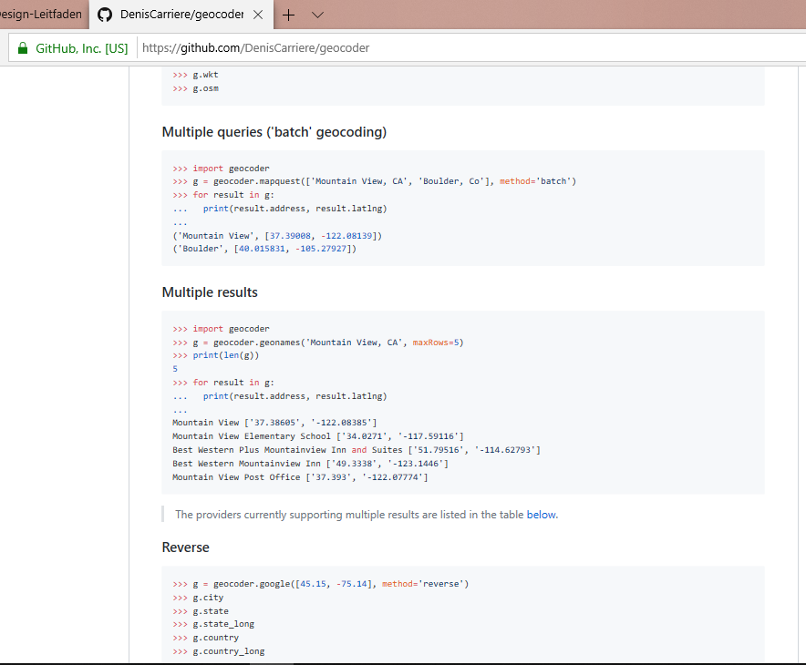
GEOCODING PLACE NAMES: VIA SCRIPT
e.g. with Python „Geocoder“, developed by Denis Carriere:
Codes for different use cases on github.com
Google or GEONAMES API key needed
Information on API registration: https://www.python-forum.de/viewtopic.php?t=44823

Slide 6
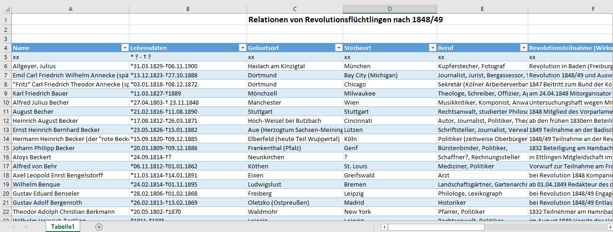
How to structure your Data in EXCEl
Unify data and avoid special characters!
One column per item!
Separate first and last names?
Enter dates in YYYY-MM-DD format!

Slide 7
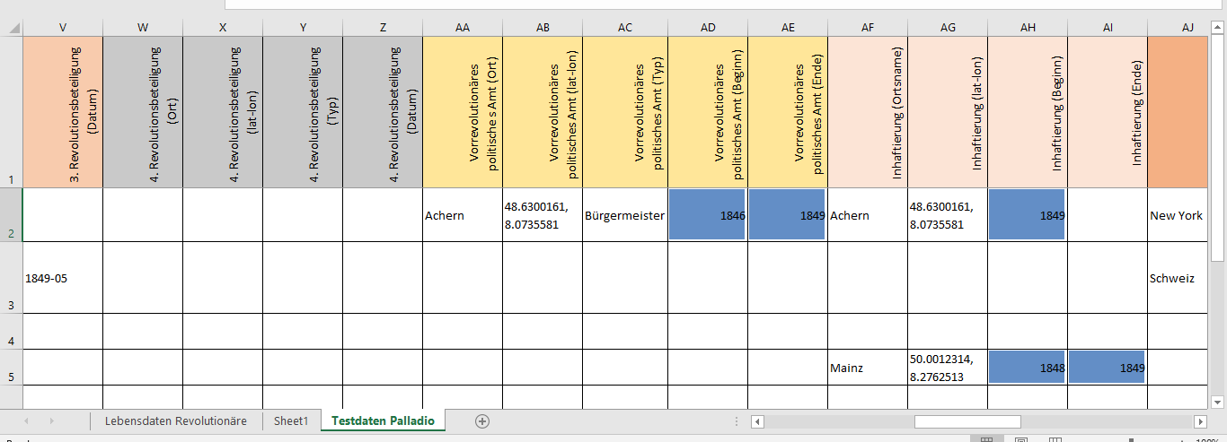
OpTIMIsed Data Structure for Visualisation Tools
Structure your excel table like a relational database and make sure that connections between items are consistent and unique. Use column names like „tags“ or „attributes“ in mark up / programming languages.

Slide 8
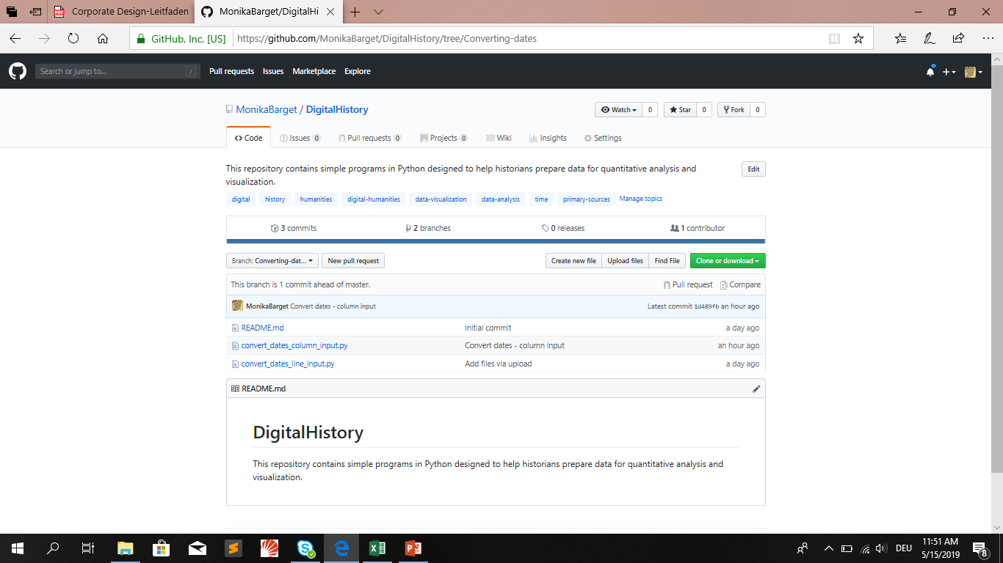
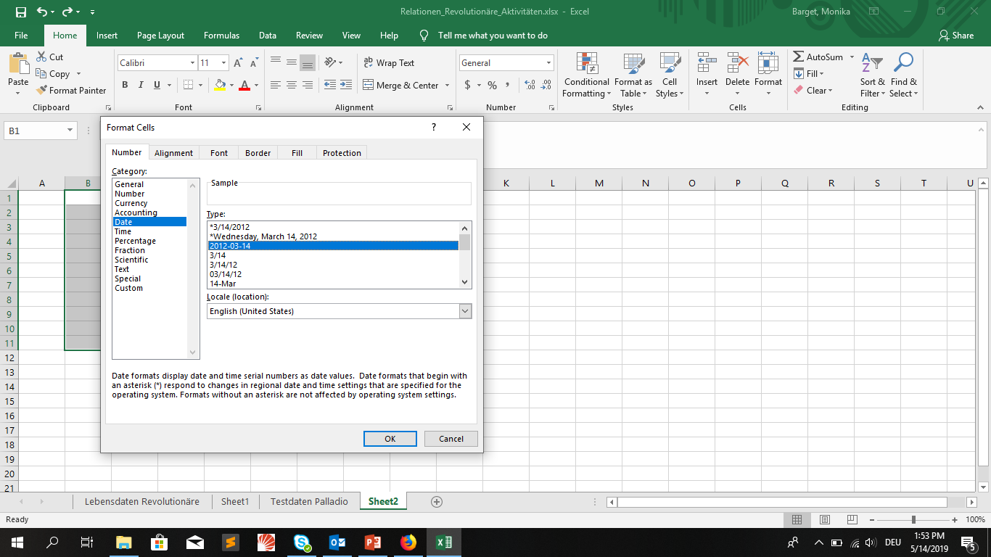
CONVERT EUROPEAN DATES TO THE YYYY-MM-DD FORMAT (E.G. for palladio)
In many cases, data can be reformatted in EXCEL. Alternatively, you can use the following Pythons scripts to convert dates from your EXCEL columns and rows: https://github.com/MonikaBarget/DigitalHistory/tree/Converting-dates

Slide 9
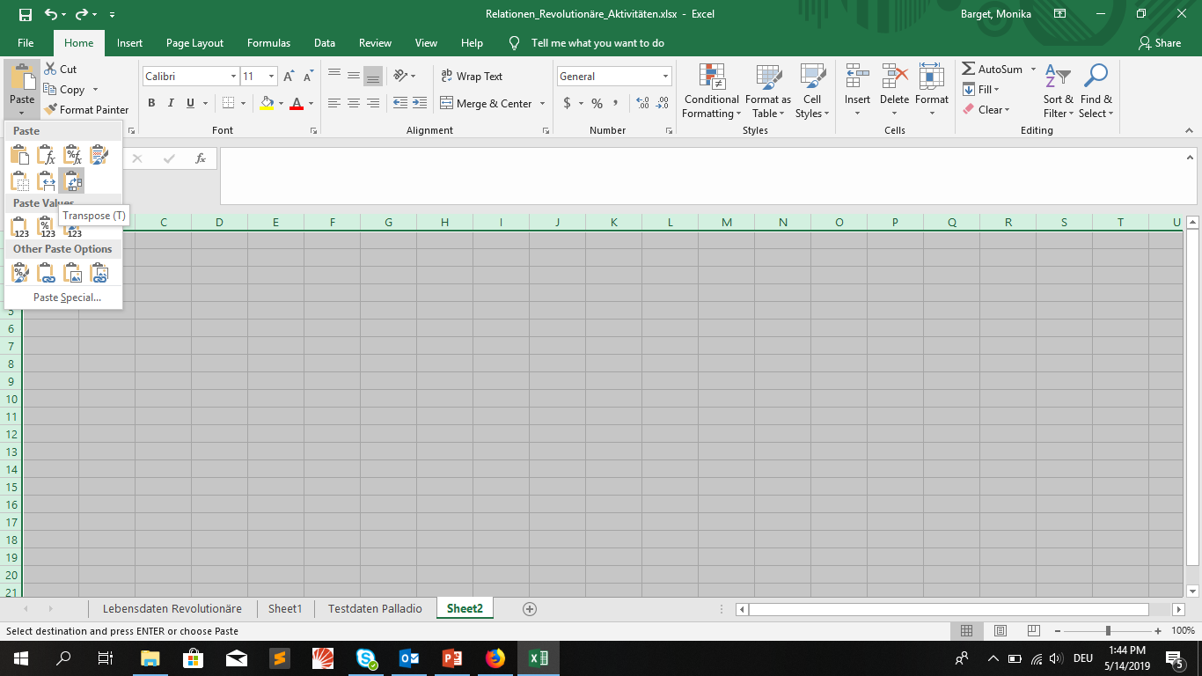
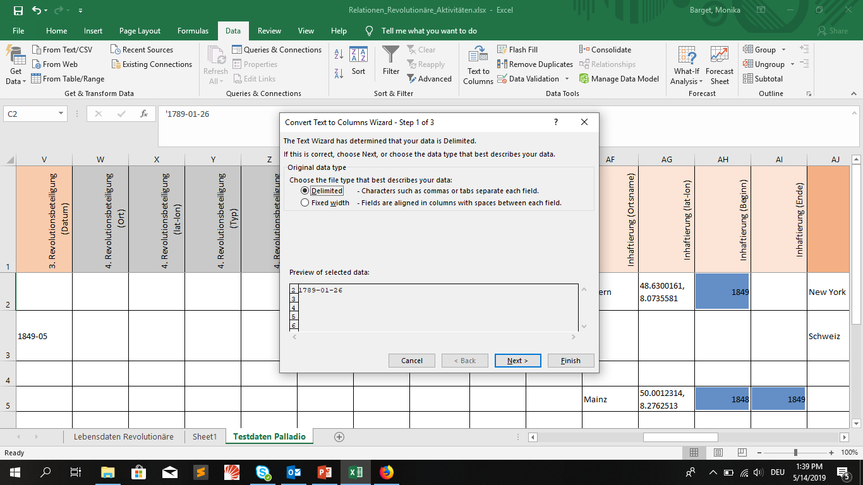
ADAPT YOUR EXCEL TABLES TO DIFFERENT USE CASES
„Text to column“ function to separate date by delimiter (e.g. commas)!
„Transpose“ function to swap columns and rows when copying data!

Slide 10
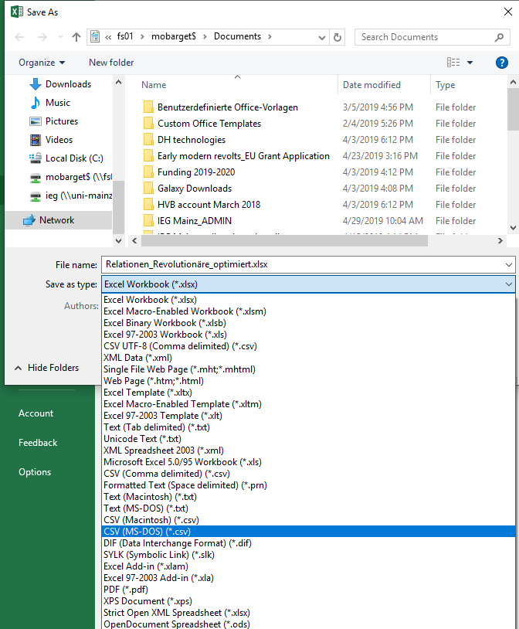
EXPORT YOUR DATA FROM EXCEL
Most visulisation tools require a .CSV („Comma Separated Value“) file. EXCEL can create .CSV files when you select „save as“ and choose CSV for Macintosh or CSV for MS-DOS from the drop-down menu.

Slide 11
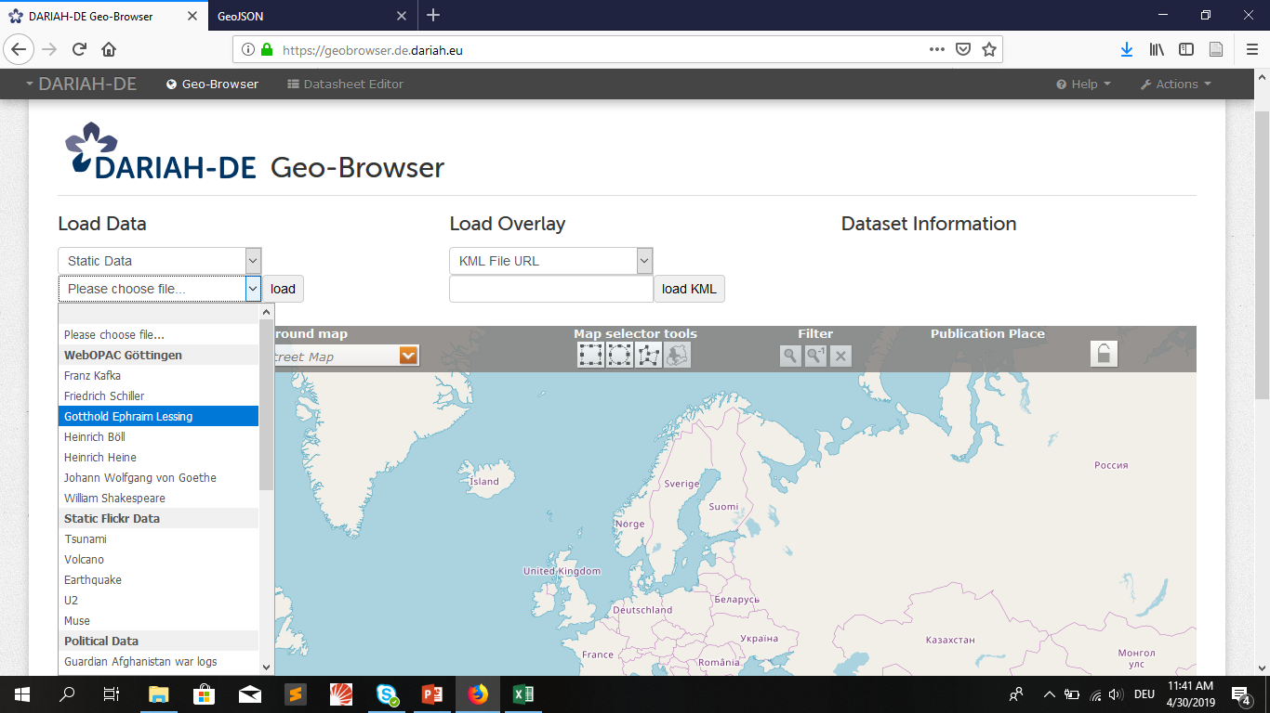
Creating Maps with DARIAH-DE Geobrowser

Slide 12
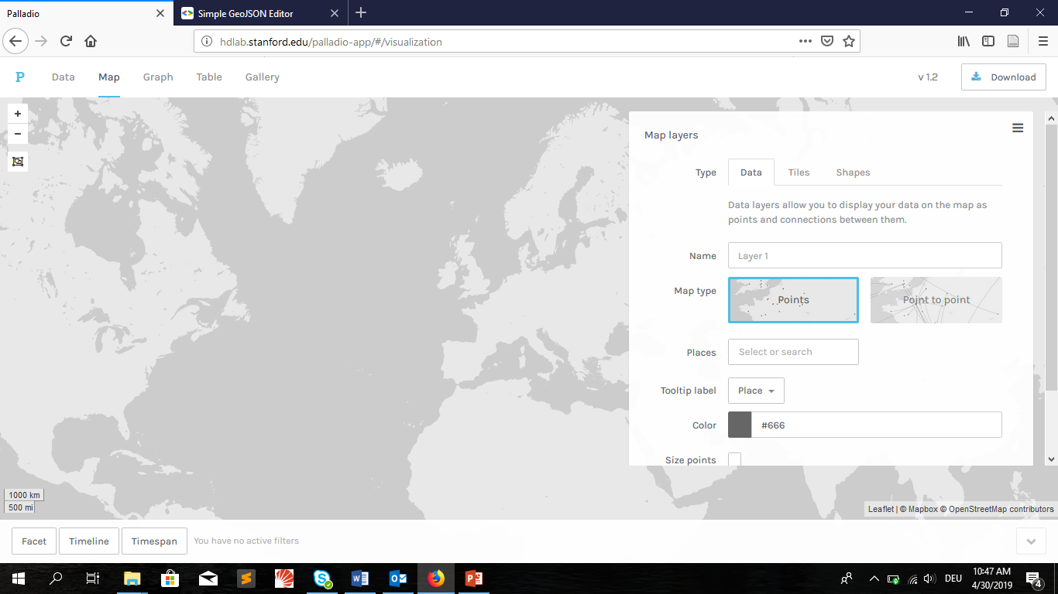
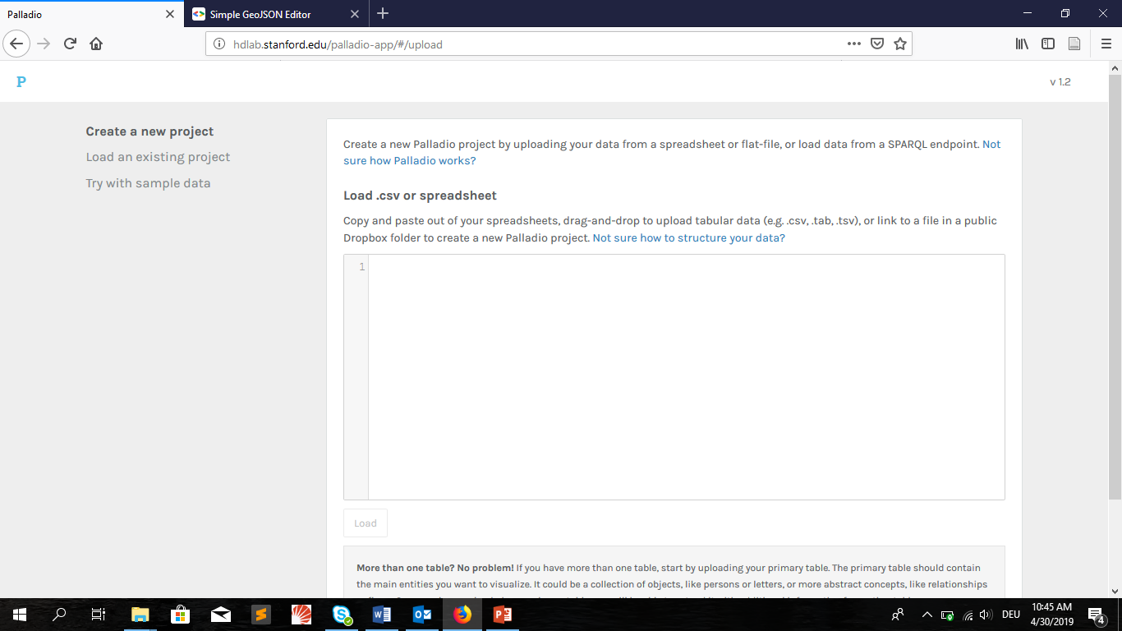
CREATING MAPS WITH Palladio (Stanford)

Slide 13
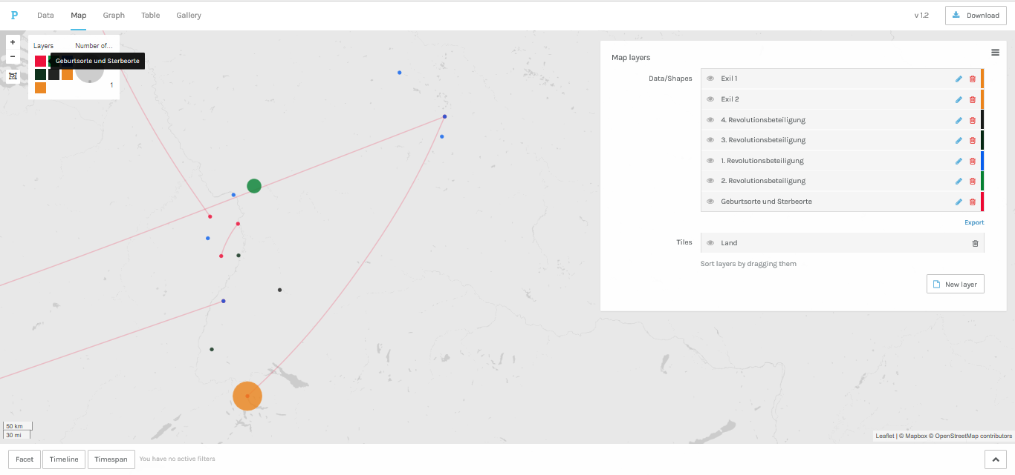
USE CASE: EMIGRATION OF GERMAN REVOLUTIONARIES 1848/1849
Für diese Karte wurden die biographischen Daten von acht beliebig ausgewählten Revolutionären verwendet. Die Ebenen („map layers“) in verschiedenen Farben können im Kasten links ein- und ausgeblendet werden. Im Kasten rechts werden die Farben und Verbindungslinien geändert. Auch die Hintergrundkarte („tiles“) kann angepasst werden. Es stehen u.a. Satellitenbilder und moderne Straßenkarten zur Verfügung.

Slide 14
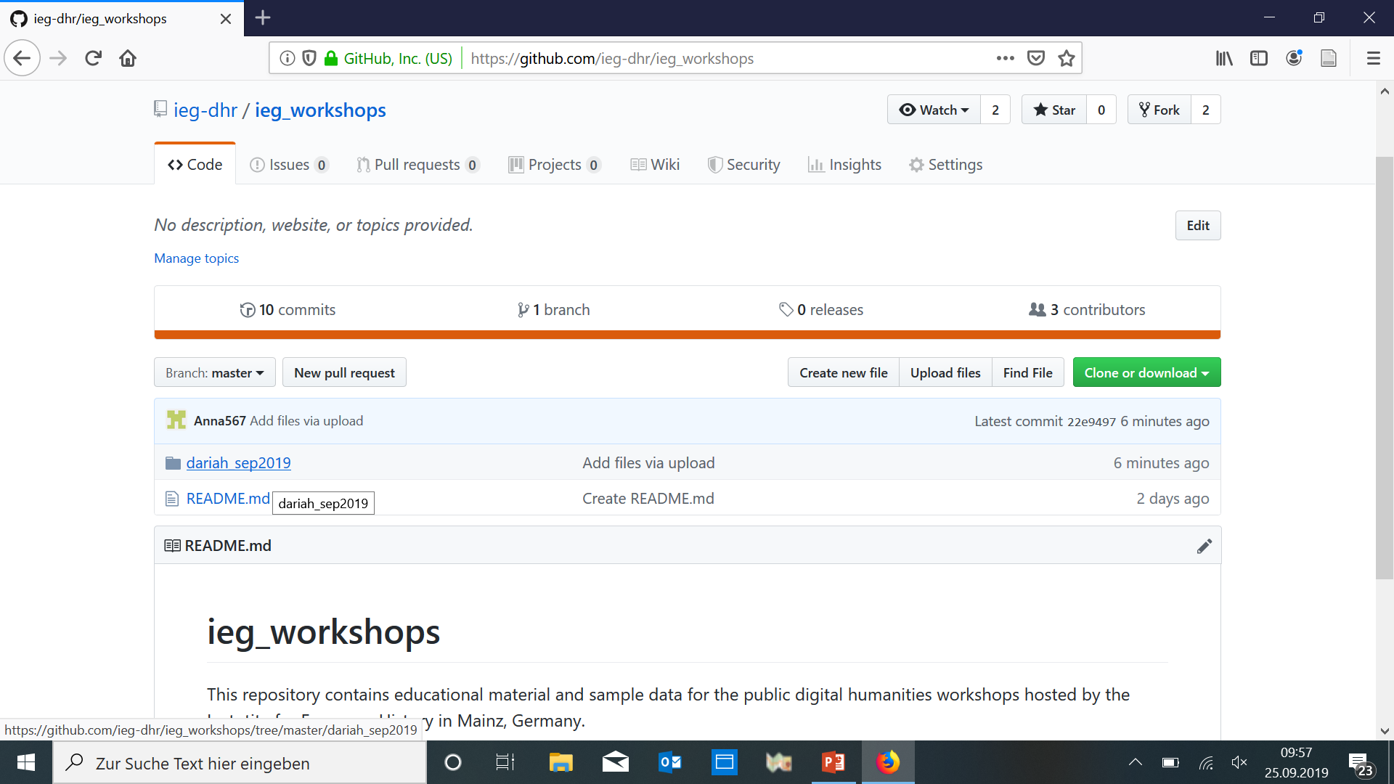
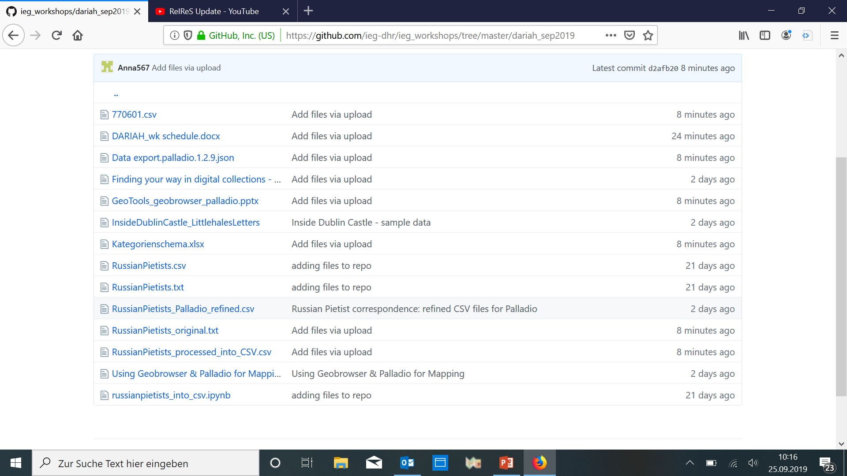
GET STARTED WITH OUR HANDS-ON SESSION
IEG Digital Historial Research on GITHUB: https://github.com/ieg-dhr/
Sample files for today‘s session: all files relating to the German Pietist community in Russia in the „dariah_sep2019“ folder

